Slide 1

Microplastic detection using microwave resonance
Amy Zhang
Jason Wu
Mackenzie Goodwin
Shaun Bradley
Vivian Mai
Department of Electrical Engineering
Department of Mechanical Engineering
Photo credit: @bruce.digital
Notes:
Hi Professor Mansour, Professor Ren and Professor Nespoli! Thanks for coming to our final presentation! Our project is microplastic detection using microwave resonator. For this presentation, we will give an overview of every important aspect of our project development journey, and we will focus on the discussion of design result and analysis. So, let’s get right into it!

Slide 2
Presentation Agenda
Organizational Roles
Motivation and Background
Need Analysis Overview
Project Objective
Design Solution Summary
Theory of Design
System-Level Design
Key Components, Specification Checks
Sample Selection
Resonator
Pump System
Arduino Shield
Design Assumptions
Result and Analysis
Test Procedure
Demonstration
Test Result
Analysis
Errors and Limitations
Improvement for Future Revisions
Primary Requirements Verification
Design for Safety, Regulatory, Sustainability
Impact of Design on Society and Environment
Project Management
Overall Project Management Strategy
Spending Budget vs. Actual Expenditure
Lessons Learned
Concepts and Terminologies throughout the Presentation
Notes:
First, let me brief you through our agenda for today.
We will start with some introductions, this includes our organization roles, motivation and background, need analysis overview and project objective.
Following that, we will provide a summary of our design solution and then dive into the details of our key system components.
We will also clarify some design assumptions made.
Then, we will show you our test results, demonstration, and analysis. We’ll give special attention to the errors and limitations, and also provide some suggestions for future revisions.
After having a whole picture of our design result, we will verify if we have satisfied our primary requirements.
Then, we’ll discuss the design considerations for safety, regulatory, and sustainability, as well as the impact of design on society and environment.
Lastly, we’ll reflect on our project management strategy and wrap up our presentation with some lessons learned along the way.
The concepts and terminologies will be introduced throughout the presentation.

Slide 3

Introductions
Notes:
So without further ado, let’s get started with our introductions.

Slide 4





Organizational Roles
Student Team
Shaun Bradley
Electrical Engineering
PCB Development
Jason Wu
Electrical Engineering
RF Design
Mackenzie Goodwin
Electrical Engineering
RF Design
Amy Zhang
Electrical Engineering
Research and Management
Vivian Mai
Mechanical Engineering
Mechanical Support
Instructional Team
Prof. Raafat Mansour
Electrical Advisor
Prof. Carolyn Ren
Mechanical Advisor
Prof. Oscar Nespoli
Course Instructor
Notes:
Let me quickly reintroduce the roles we play in our team.
Four of us are from electrical engineering: Shaun mainly focuses on the PCB development, Mackenzie and Jason are the leads for our radiofrequency design development. I am Amy, and I am responsible for research and management of timelines and deliverables.
And Vivian is from mechanical engineering providing all the necessary mechanical support.
And we would like to first express our sincere thanks to all of you, Professor Mansour our electrical advisor, Professor Ren our mechanical advisor, and Professor Nespoli our course instructor for spending time to provide us with all the useful insights throughout this whole project.

Slide 5
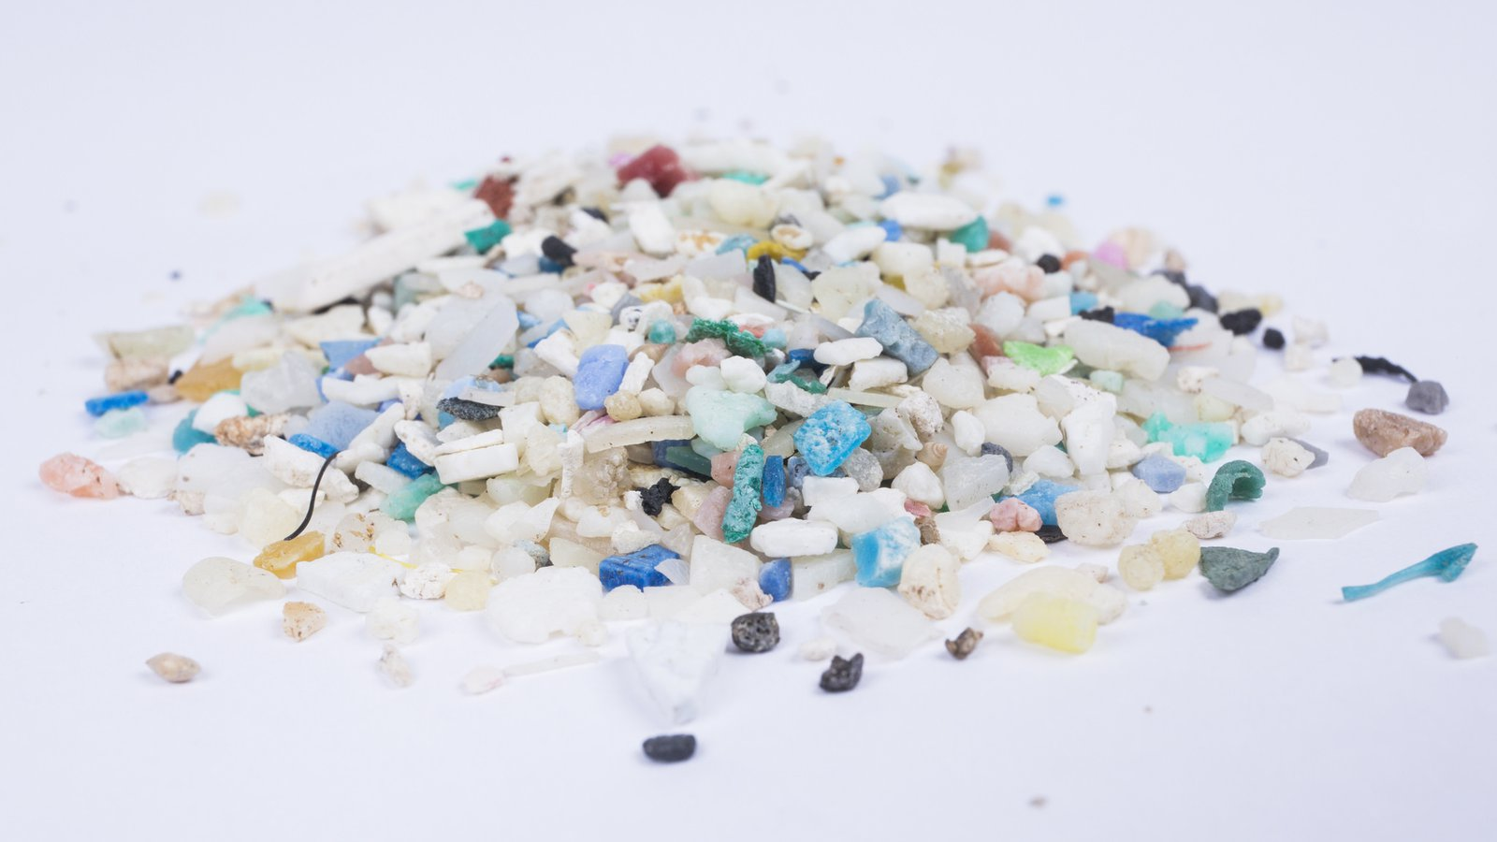
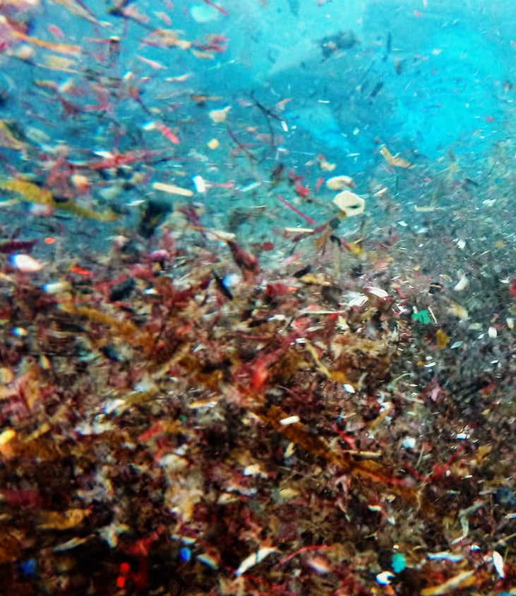
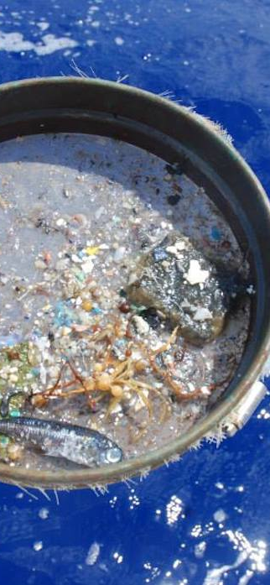
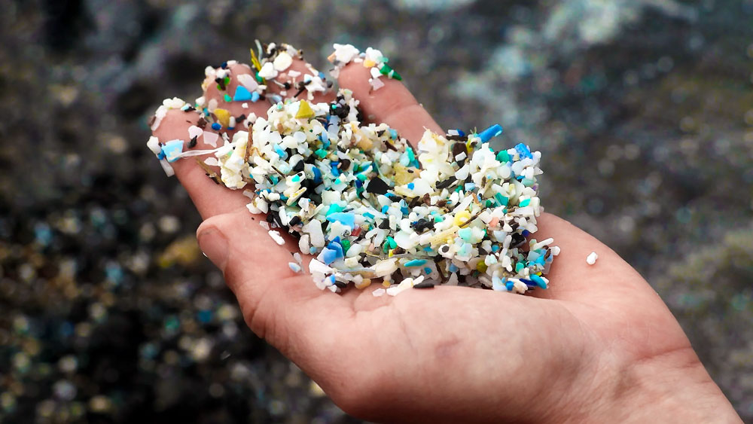
Motivation and Background
Microplastics
Any plastic fragment with diameters < 5mm.
Sources
Laundry
Skincare Products
Processed Foods
They are everywhere in life
Statistics
After collecting rainwater and air samples for 14 months, scientists found 1000 metric tons of microplastics (equivalent of over 120 million plastic water bottles) in 6% of the total US area [1].
Notes:
Now let’s have a quick refresher of our motivation and background.
Microplastic is any plastic fragment with diameters less than 5mm. It can come from many sources, such as the fabrics breaking apart in our laundry machine, the exfoliants in our skincare products, and the processed foods. A more solid piece of statistics is that the amount of microplastics found in rainwater is equivalent of over 120 million plastic water bottles in just 6% of the total US area, which is roughly the same size as our province of Ontario. It not only is a burden to the environment, but also has negative impact.

Slide 6

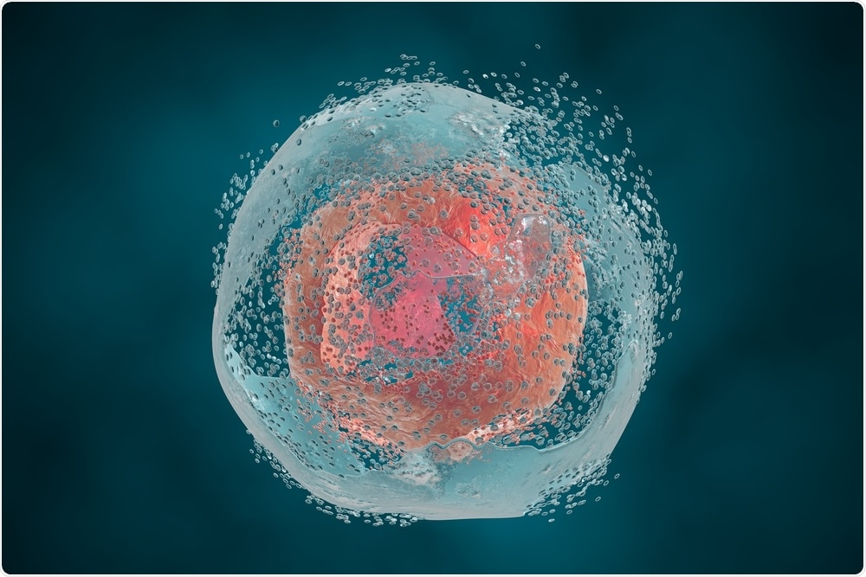
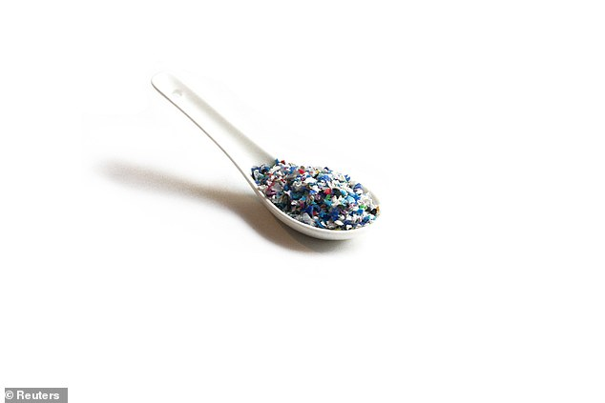
Motivation and Background
Disturbs the Ecosystem
Reduce Predatory Performance
Reduce Reproduction [1]
Harmful to Human Body
Lead to Cell Damage & Death [3]
Cause Inflammatory Bowel Disease [2]
Adults consume 5g of plastics a week! [4]
Unborn babies can consume microplastics from placentas! [3]
Notes:
It can disturb the ecosystem by reducing the predatory performance and reproduction ability of marines lives.
It can harm our human body by causing cell deaths, and inflammatory bowel disease.
It is alarming as adults on average have been consuming 5g of plastics per week.

Slide 7
Need Analysis
Importance of Microplastic Detection
Water quality analysis
Pollution trend
Organism exposure
Prediction of areas with imminent threat
Problem with Existing Technologies
Current Methods for Microplastic Detection ​​
Microscopy: ​​ Fluorescent-Tagging​​ | Fourier Transform Infrared Spectroscopy​​ | Raman Spectroscopy​​
Time-consuming​​ | Heavy sample preprocessing – Time consuming​​
Costly ​​ | Costly​​
Poor in test accuracy​​ | Improved test accuracy​​
Notes:
So with that said, microplastic detection is critical, especially for water quality analysis.
Early in the project, we have conducted need analysis to examine the problems with the existing microplastic detection technologies, which are summarized in the table on the right.
There two major issues: the test is very slow, and the setup is expensive. And these are the areas we want to improve with our design.

Slide 8
Project Objective
Project Objective:
Develop a technological demonstration of a rapid, accurate and affordable microplastic detection device.
Proposed Solution:
Employ resonance microwave spectroscopy and fluidic system for microplastic detection.
Note:
1. This is not a product. This is a technology demonstration.
Potential Sectors: research teams, waste-water tube facilities, agricultural industries.
2. RF design is a very difficult field.
3. The microplastic is purchased virgin plastic, not plastics from the environment.
Notes:
So our project objective is to develop a demonstration of a rapid, accurate and affordable microplastic detection technology. And our proposed solution is to employ resonance microwave spectroscopy and fluidic system.
We’d like to stress that given the limited time and the immense depth of RF design, we are not developing a product, but a technological demonstration that could potentially be used in many sectors.
And for this reason, we are using the purchased virgin microplastics instead of plastics found in lakes.

Slide 9
Design Solution Summary
Notes:
Now, let’s have a look at our design solution summary!
But before the details, I’ll brief you through some terms and concepts.

Slide 10
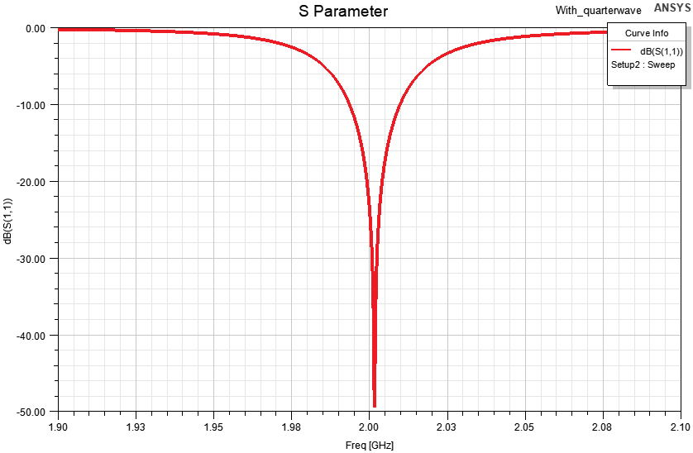
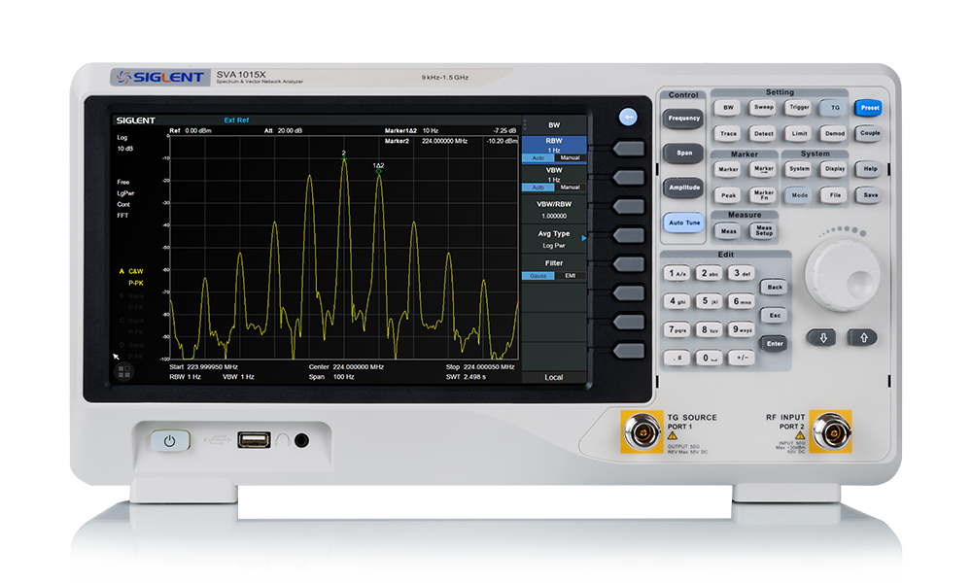
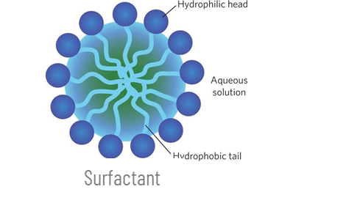
Concepts and Terminologies
RF Resonator: a structure that naturally oscillates with greater efficiency at certain frequency
Resonant Frequency: frequency at which the system most naturally resonates at
S11: Measures the ratio between the incident wave and the reflected wave
Resonant Magnitude: describes how efficiently the system resonates, measured in dB
VNA (Vector Network Analyzer): device for measuring radio frequency characteristics
Dielectric Constant: the permittivity of a material expressed as a ratio with the electric permittivity of a vacuum.
Surfactant: Lowers the surface tension between a solute and a solvent to allow for better mixing. Addition of a surfactant to the microplastic solution aids in uniformly dispersing the microplastics.
S11 at 2GHz
Vector Network Analyzer (VNA) [5]
Notes:
An RF resonator is a structure that naturally oscillates with greater efficiency at certain frequency, and this specific frequency is called the resonant frequency.
S11 is an important s-parameter metric that measures the ratio between the incident and reflected wave of a microwave system.
Resonant magnitude, or S11 magnitude describes how efficiently the system resonates at, measured in dB.
And VNA (which stands for vector network analyzer) is what we use to measure the radio frequency characteristics that we just discussed.
The dielectric constant is the permittivity of a material expressed as a ratio with the electric permittivity of a vacuum.
The surfactant is a chemical agent that lowers the surface tension between a solute and a solvent to allow for uniform dispersion. Addition of a surfactant to a microplastic solution helps maintain homogeneity of the solution.

Slide 11
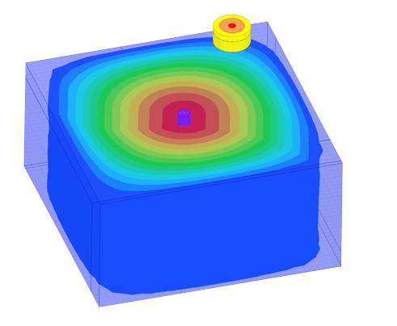
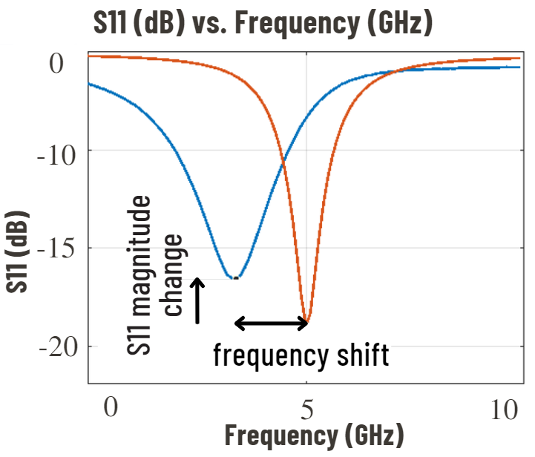
Theory of Design
Port connected to VNA
Fluidic Channel
When microplastic solution is present in the fluidic channel, the dielectric property of the channel changes, which results in 2 measurable changes:
Resonant frequency shift in S11
S11 magnitude change
Cavity Resonator in Simulation
S11 Response to Dielectric Constant Change
Notes:
So the theory of design is illustrated in these graphs. The colorful box at the top is a simulation diagram of an RF resonator with a fluidic channel going through the center, and the VNA will send signal to the port and cause an electric field in the resonator. The bottom graph shows the S11 change in response to dielectric constant change.
Theoretically, when the microplastic solution is in the fluidic channel, depending on the concentration level, you will see change in the dielectric property. And this change is reflected in 2 measurable aspects:
1.The primary response is the resonant frequency shift in S11.
2.And the secondary response is the S11 magnitude change.
With these in minds, we will have a look at our system level design.

Slide 12
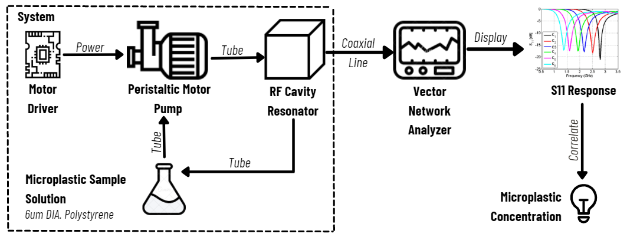

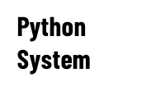
System Level Design
Design Methods:
Research
Simulation
Iterative prototype testing
Notes:
So this is our system level diagram. The parts in the box indicate our design scope. The sample solution will be pumped from a reservoir to the tubes to circulate in the system. The RF cavity resonator has a fluidic channel in the middle for the solution to pass through. And measurements will be taken to the VNA to display using the coaxial line. With known microplastic concentration of the sample, we will correlate the S11 response change with the sample’s concentration. This is done using a python system. The python script will organize all the data into graphs and build approximation model. Due to the time constraint, we’ll not focus on the python aspect today but the details are explained in our final report.
For our overall design strategy, we follow the steps of research, simulation, and iterative prototype testing.

Slide 13
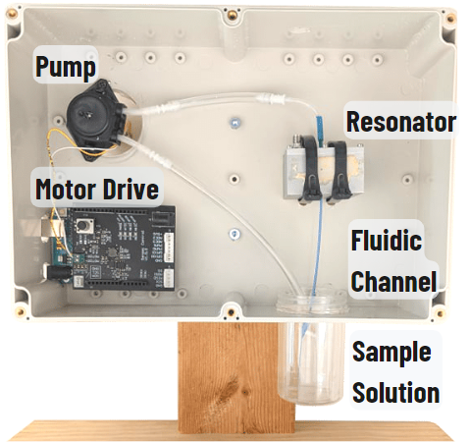
Final System Set-up
System Set-up
Notes:
Now coming back to the main system, this is our final system setup. As you see, the key components are the motor drive, pump, resonator, fluidic channel, and sample solution. So in the next few slides, we will take a closer look at each of these components. We’ll talk about their major functions, the design assumptions made, as well as some quick specification checks.

Slide 14
Sample Selection
Solutions mixed by lab at the University of Guelph with surfactant to be added from Microfluidics lab
Microfibers considered due to abundance but difficult to obtain; most prevalent microplastics found in the environment are polyethylene, polypropylene, and polystyrene [6]
Final sample choice determined by microplastic abundance in the environment and availability [6]
Plastic Type | Plastic Size (um) | Concentration (ppm) | Volume (mL/sample)
Polyethylene | 10-32 | 100-1300 | 5 x 100
Polystyrene | 6 | 50-130 | 100
Notes:
The choice of microplastics to be used was determined by microplastic abundance in the environment, as well as availability. While microfibers were considered for testing due to prevalence in the environment, they are difficult to obtain, and ready availability of microspheres made them most suitable for testing. Studies have also shown that the most abundant microplastics found in Mediterranean waters were polyethylene, polypropylene, and polystyrene. The solutions were mixed by a lab at the University of Guelph, and thus availability to them was crucial. While they possessed a supply of polyethylene and polystyrene, they did not have polypropylene. The final sample choices and their parameters can be found in this table. It should be noted that polystyrene was the primary sample used in testing due to it better mixability.

Slide 15
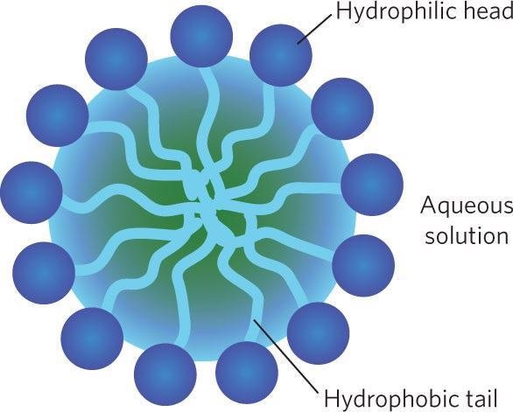
Sample Selection: Surfactant
Surfactant would be used for uniform dispersion of solid-liquid microplastic solution
Intention of polysorbate-20 surfactant use from early stages of design
Surfactant leaves behind a residue that can only be fully removed with acetone, which would dissolve the plastic tubing
Future iterations of project may involve a disposable or non-plastic tubing system for use with a sample with surfactants
Notes:
From the early stages of the design, it was advised by Professor Ren to use a surfactant to uniformly disperse the microplastics in the solution in order to obtain the most ideal performance from the resonator. However, some issues arose after a consultation with a postdoctoral researcher of the Microfluidics lab, which informed us of its tendency to leave behind a residue that is difficult to clean. This would lead to residue and potential microplastic particles becoming stuck in the tubing and affecting future samples. The only way to clean the system would be to flush it with acetone, however that would have degraded the plastic components, so it was not an option. After some consideration, it was determined that surfactant would ultimately not be used, as it may significantly affect results. Future iterations of the sample preparation process and design may use a disposable tubing system with a sample that includes surfactant, but at the moment that is outside the scope and budget of the project.

Slide 16
Sample Selection: Specification Check
No. ​ | Characteristics Description ​ | Verification Method​ | Verification Details​
2.1 Mechanical - Sample Selection​
2.1.1 | The diameter of the channel going through the resonator shall not exceed 0.5mm. | Examination | The microfluidic tubing used had a diameter of 0.4mm, which is less than the limit.
2.1.2 | The maximum particle size shall be less than 25% of the inner diameter of the smallest tubing or channel. | Examination | The tested microplastic bead size was 6µm, which is smaller than the limit value.
2.1.3 | Surfactants shall be introduced to the solution to create a uniform distribution of microplastics. [Update] | Examination | Uniform distribution as verified through a visual analysis of the samples.
Notes:
Now I’ll just quickly review and verify the engineering specifications we previously defined. We have confirmed that the diameter of the channel going through the resonator did not exceed 0.5mm by buying and using tubing with a diameter of 0.4mm. We ensured that the maximum particle size was less than 25% of the smallest tubing diameter by testing primarily with a microplastic bead size of 6 microns. The final specification of this section was modified for a system not using surfactant, and uniform distribution was roughly verified through a visual analysis of the samples.

Slide 17
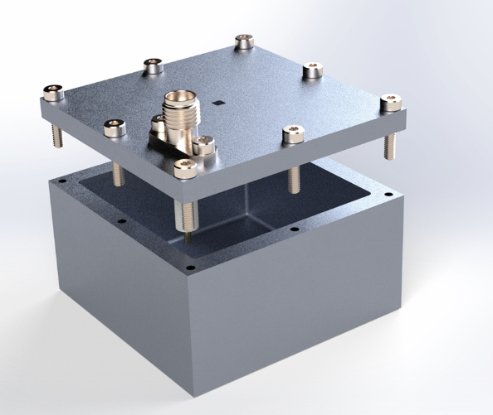
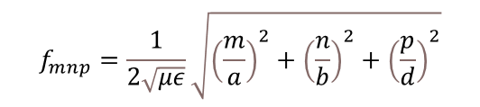
Cavity Resonator
The resonator is a metallic device which electrically resonates at a specific frequency.
Design Goal
To optimize the sharp dip (high Q-factor) of S11 response such that the resonator is sensitive to many concentration change.
Port
Location is determined to maximize the electric field in the center
Port length adjusted to optimize the impedance matching between the transmission line and the resonator
Resonator Dimensions
- Related to the resonant frequency
$$f_{mnp}=\frac{1}{2\sqrt{με}}\sqrt{{\left(\frac{m}{a}\right)}^{2}+{\left(\frac{n}{b}\right)}^{2}+{\left(\frac{p}{d}\right)}^{2}}$$
m,n,p: the wavenumbers
a,b,d: dimensions of the cavity
Fluidic Tube Placement
Through the center
Highest E-field at center
Resonator more sensitive to change
Port connected to VNA
Fluidic Channel
d
a
b
Notes:
Now, I will introduce you to the main part of our system: the cavity resonator.
The resonator is a metallic device which electrically resonates at a specific frequency. The design goal is to create a device that changes its resonant frequency when a change in microplastic concentration is run though the microfluidic channel.
The resonance is created by injection of radio waves (using a VNA) into the resonator via an injection port. When the sample solution is run through the microfluidic channel, the dielectric constant within the resonator is changed resulting in a unique resonant frequency with a unique magnitude.
The microfluidic channel is placed at the center of the resonator as this is high area with the highest E field concentration which allows for the highest coupling of the RF energy to the channel – allowing for the resonator to be more sensitive to a change in microplastic concentrations.
The location of the port was selected to optimize the electric field strength in the microfluidic channel and was found by running iterated simulations. In addition, the port length was tuned to optimally match the impedance between the resonator and transmission line and resonator.

Slide 18
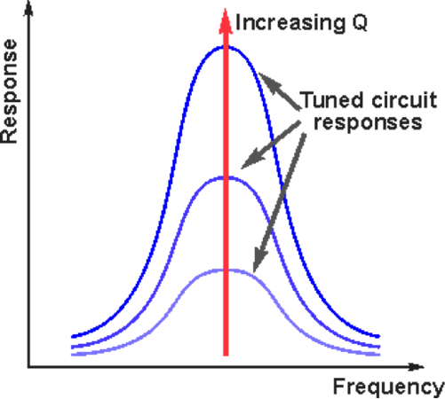
Concepts and Terminologies
Q Factor: describes how sharp of a peak the system's frequency response has
Q Factor Frequency Response
Notes:
For the resonator, it is desired to have a high Q factor. The Q factor described how sharp of a peak the system's frequency response has. So higher Q factor indicates higher sensitivity for detecting concentration change.

Slide 19
Resonator: Specification Check
No. ​ | Characteristics Description ​ | Verification Method​ | Verification Details​
3.2 Electrical System - Cavity Resonator​
3.2.1 | The resonator shall have a length, width and height of 4cm, 4cm and 2cm, respectively.​ | Examination​ | The dimensions of the cavity determine the operating frequency of the device. Calipers will be used to measure this dimension.​
3.2.2 | The tolerance of the dimensions shall be smaller than 0.3mm.​ | Examination​ | Since the dimensions determine the operating frequency changes of larger than 0.3mm greatly affect the frequency. This will be measured with a caliper.​
3.2.3 | The system shall have an aluminum wall thickness between 2mm and 1cm. | Opinion by recognized expert | The wall thickness has a minimum requirement of 2mm but anything above just adds weight.
3.24 | The cavity resonator shall have a Q factor greater than 1000. | Test | This requirement has been satisfied as the lowest Q factor observed across all the trials is 1317.1.
Notes:
We are now revisiting the design requirement defined early in the project. All the requirements for the resonator were met.
One of the important requirements is the dimensions for the resonator, which have be verified using the caliper measurement.
The other important requirement is the cavity resonator shall have a Q factor of greater than 1000. This is also met as the lowest measured Q factor was 1371.1 during test.

Slide 20


Pump System
Delivers microplastic sample to the resonator via the microfluidic channel
Flow rate was measured at 5% increments in duty cycle at frequencies: 0.5 kHz, 5 kHz, and 50 kHz
0.5 kHz has better, more linear behaviour
Intermediate Tubing
Microfluidic Channel
Flow Rate [mL/min]
Resonator
Reservoir
Wire
Pump
Arduino Shield
Duty Cycle [%]
Notes:
The function of the pump system is to deliver the microplastic sample to the resonator. This is achieved by using a peristaltic pump, which is a type of pump that allows for contactless pumping – minimizing the contact between the microplastic sample and the system. The pump is connected to intermediate tubing which serves the purpose of connecting the pump to the microfluidic channel that runs through the resonator. The reservoir is used to house the prepared sample solution to be delivered to the resonator.
Operating conditions for the motor needed to be characterized as they were not provided by the manufacturer. To find the flow rate, the time required to fill 50mL of water was recorded for Duty Cycles at 5% intervals and at frequencies: 0.5 kHz, 5 kHz, and 50 kHz. The results demonstrate that higher frequencies do not allow for operating of the motor less than ~25% and overall higher frequencies have a more non-linear behavior which is undesirable. The pump is thus operated at a switching frequency of 500 Hz and connected as shown in the diagram.

Slide 21
Pump System: Specification Check
No. ​ | Characteristics Description ​ | Verification Method​ | Verification Details​
2.2 Mechanical - Pump System​
2.2​.1 | The flow rate of the solution through the flow system will not exceed 100mL/min.​ | Test​ | Measure the flow rate using flow meter (35 mL/min)
2.2.2 | The sample solution reservoir in the pump system shall employ stainless steel, other metals with strong bonding, or glass material for minimal contamination.​ [Update] | Test​ Examination​ | Ensure the purchased reservoir material is glass.​
2.2.3 | The solution volume shall be within 100-200mL. | Examination | The sample solutions used were made in batches of 100mL samples.
Notes:
There are design requirements that are specific to the pump system. All requirements are met.
Notably, the first requirement is that the system’s flow rate is kept under 100mL/min was met as the maximum flow recorded was 35 mL/min during testing.

Slide 22
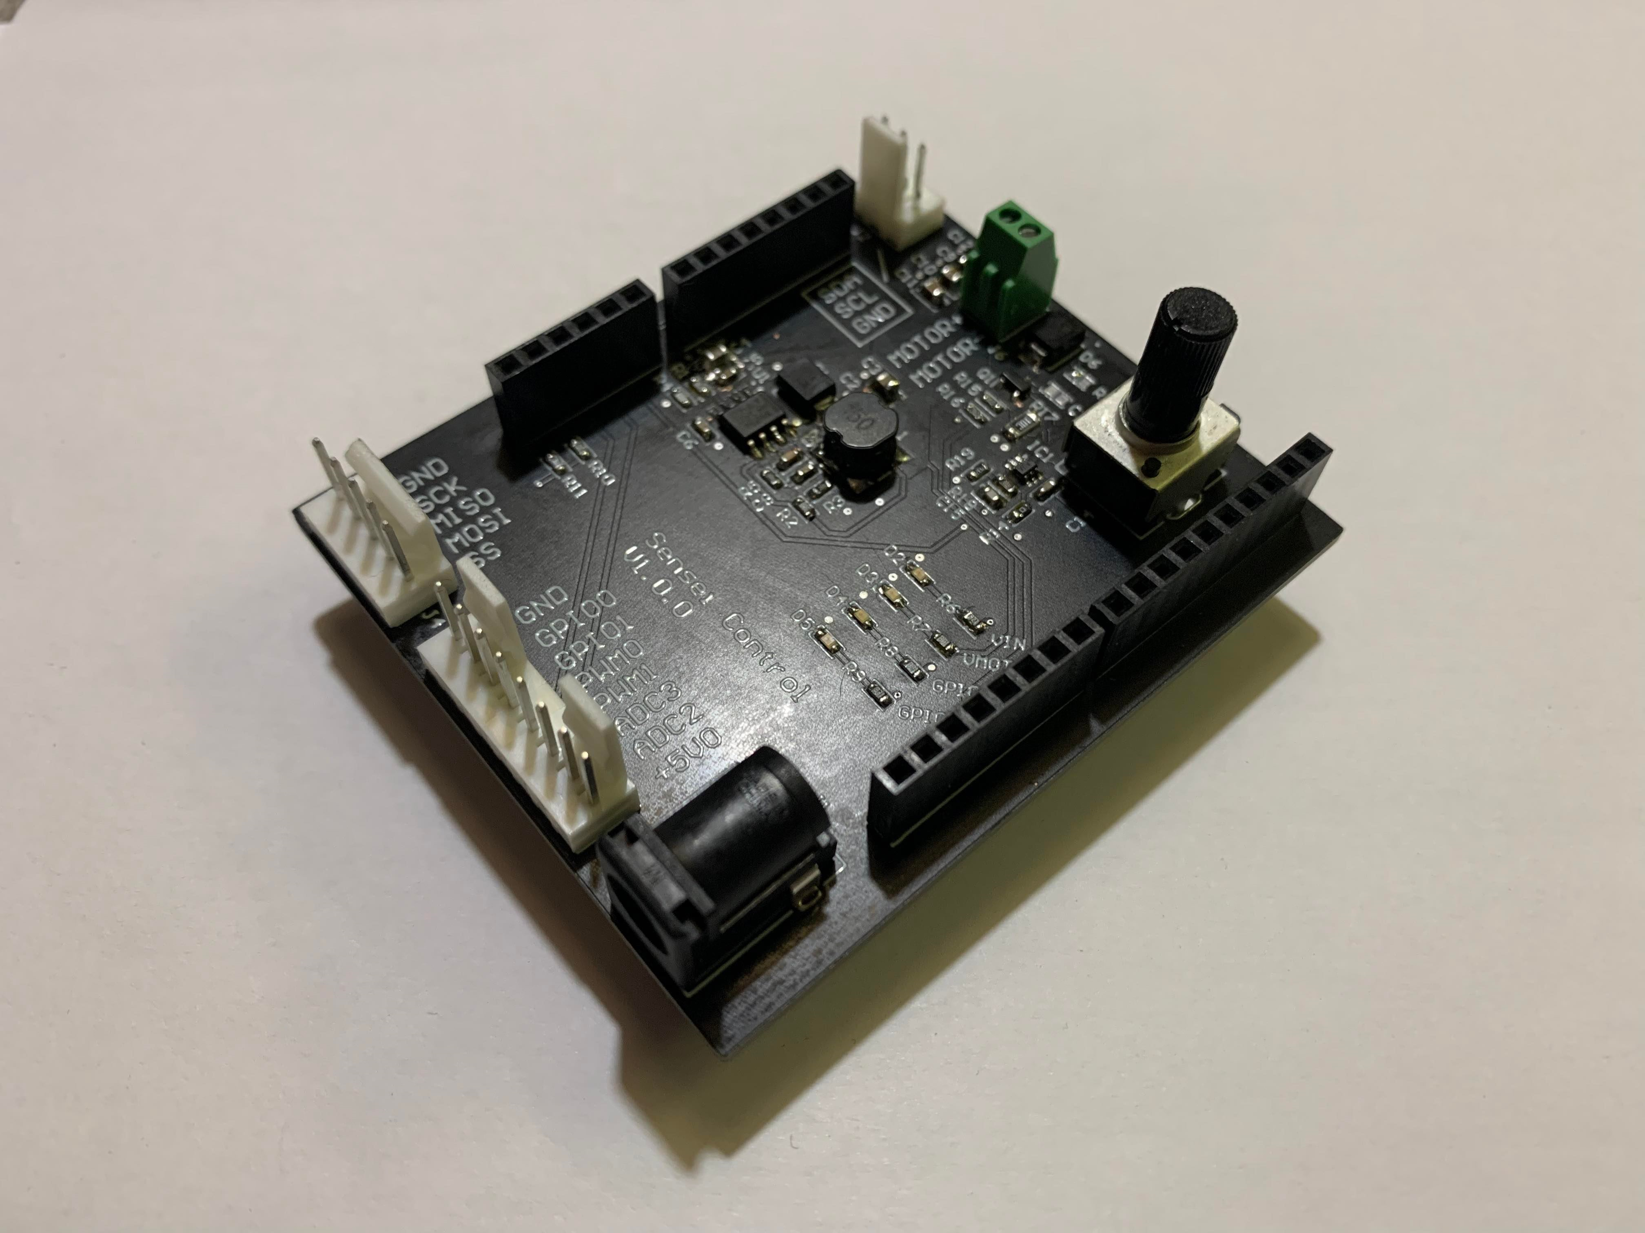
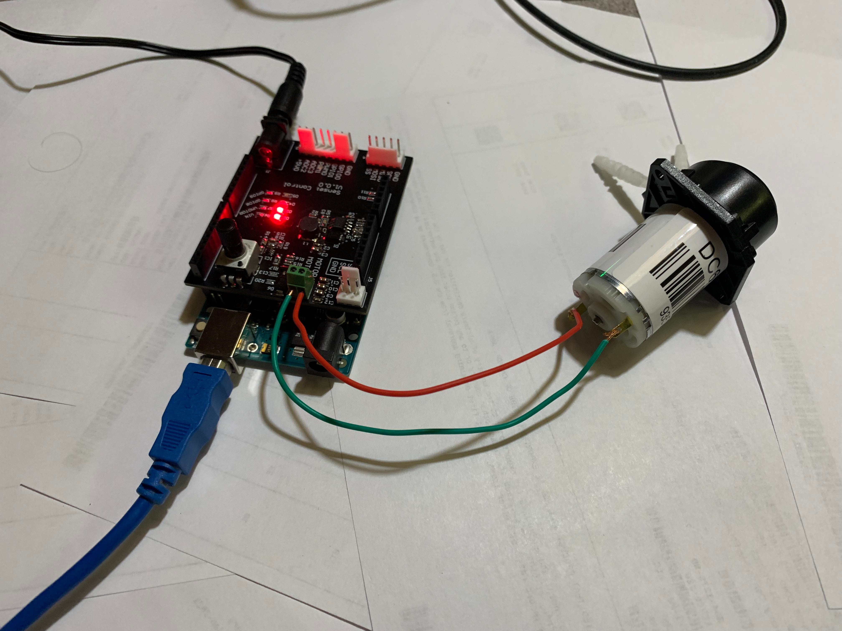
Pump System: Arduino Shield
A PCB interfaces with an Arduino Uno
Converts 12 VDC input to 6 VDC
Provides up to 1A for the motor
Motor driver circuit with manual speed control
Arduino pinouts for potential sensor
5V, 3V3 voltage rails
I2C, SPI, 4x GPIO
2 ADCs
Status LEDs for debugging purposes
Notes:
After designing and testing the pump system circuit on a breadboard, we decided to put the entire circuit on an Arduino shield style PCB. This PCB serves as an interface between the Arduino Uno and the rest of our system. It converts a 12VDC input to a regulated 6 VDC output rail. This rail is meant to power the motor and provides up 1A maximum steady state current draw. And to allow debugging, it also has the feature to manually control the speed of the motor by twisting a variable resistor. The communication lines on the Arduino are also brought out onto this board, they can be easily accessed in case we need additional sensors.

Slide 23
Design Assumptions
Category | Assumption
Sample Selection | Running the sample through the system would not break its uniformity. Homogeneity is thus a problem that only needed to be addressed at the sample preparation stage.
Sample Selection | Concentration of microplastic samples obtained was accurate, consistent, and contamination-free to a reasonable degree, thus the S11 response corresponded to the actual concentration level.
Pump System | Flow rate remains constant during operation.
Resonator | The S11 response correlates only to a concentration change of microplastics.
Notes:
When developing this design, a few assumptions had to be made to ensure that this project remained within our scope. Regarding sample selection, we assumed that running the sample through the system would not break its uniformity, and thus, homogeneity was only an issue to be addressed at the sample preparation stage. It was also assumed that the concentration of the microplastic samples obtained from the Guelph lab were accurate, consistent, and contamination-free to a reasonable degree. The pump system assumptions imply that the flow rate is constant during operation. It was finally assumed that the S11 response correlates only to the change in concentration of the microplastics, and no other factors, and so a direct relationship can be found between them.

Slide 24
Test result and analysis
Notes:
Now, let’s go through the result and analysis

Slide 25
Test Procedure
Tuning
Finding Initial Reference
Running Trials
Cavity resonator is tuned in the presence of water in the fluidic channel
Ensures basic measurement accuracy
Run the system with water (0ppm microplastic sample)
Record S11 response
Serves as reference point
Conduct multiple trials for each sample
Run the system with water for 2min to clean in between trials
Record data for the concentration level after observing consistent result across multiple trials
Notes:
We have summarized our test procedures into steps.
The first step is tuning. We tuned the cavity resonator in the presence of water in the fluidic channel by gradually cutting the length of coax going into the resonator until a sharp s11 response is observed.
Then, we ran the system with water and record the S11 response. This establishes the initial point of reference for any comparisons with sample solution.
And the last step is running trials. For each sample solution, we conducted multiple tests, and recorded the data into a spreadsheet. And between different trials, we cleaned the tubing by flushing the system with water for 2 minutes to flush out any remaining residues.

Slide 26
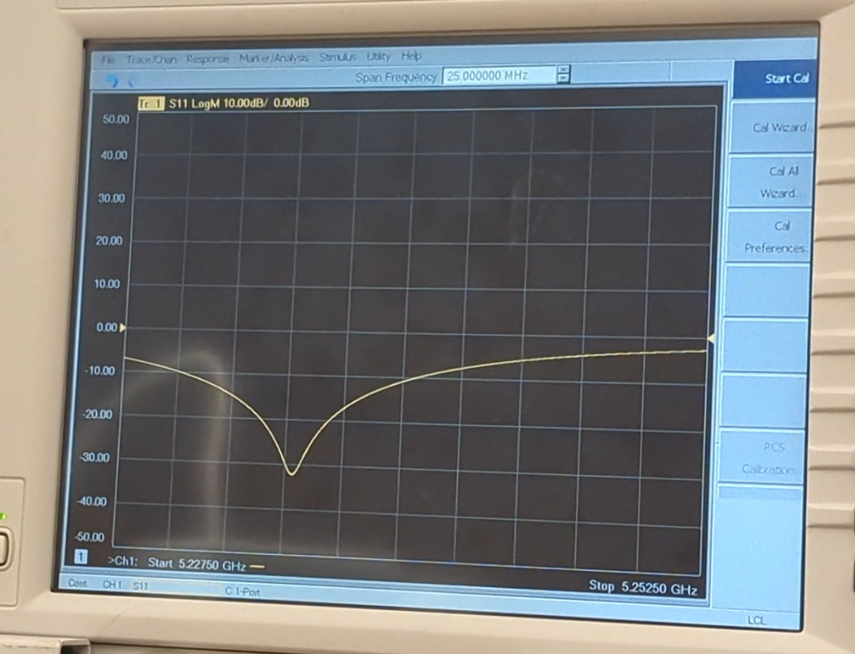
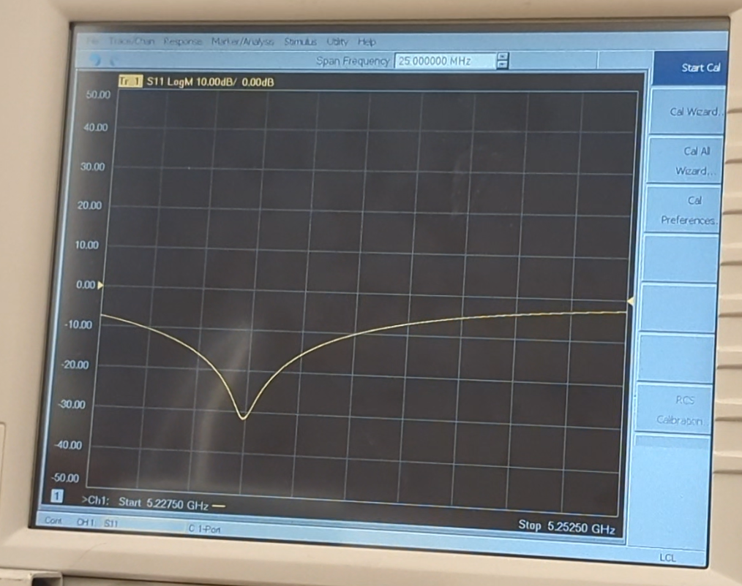
Demo: Water vs Microplastic Result Comparison
Water
(0ppm)
Microplastic Solution
(300ppm Polystyrene)
Notes:
So here are the final VNA displays of the two demos we just watched. The picture on the left is the water test, and the picture on the right is the microplastic test.
The resonant frequency is around 5.3GHz, and the S11 magnitude is around -30dB.
But if you look closely, the two plots are different. Comparing to the microplastic solution test, the s11 dip of the water test has slightly shifted to the left, and it has also shifted upward. This indicates a decrease in resonant frequency and an increase in S11 magnitude for the sample solution.
One thing I would like to note is that the S11 response we see here is not the same ones we used for data analysis. This is because the demo video was taken earlier this week, and our pump system was already contaminated with surfactant residues from previous tests, so the readings in the demo is not accurate. However, the purpose of the demo is to show how the system operates, and the trend between different solutions, and that is clearly shown here.

Slide 27
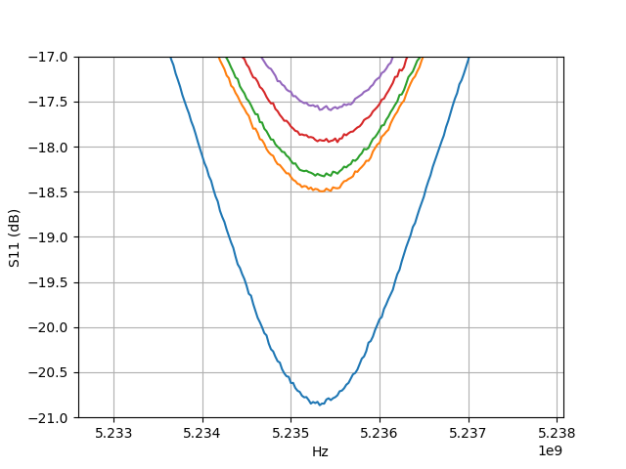
Test Results
S11 Magnitude
Res0nant Frequency & Magnitude
Colour | PPM | Resonant Frequency (Hz) | Minimum Magnitude (dB)
Blue | 0ppm | 5235325000 | -20.86
Orange | 300ppm | 5235350000 | -18.49
Green | 500ppm | 5235375000 | -18.33
Red | 700ppm | 5235525000 | -17.95
Purple | 900ppm | 5235450000 | -17.59
Notes:
Mackenzie
Now I’ll go over our results from testing.
Looking at the results graphed on the left, with an increase in concentration there was an increase in the s11 magnitude and no significant frequency shift.
The original metric to determine the concentration of the microplastics was a change in the dielectric constant leading to a resonant frequency change.
From the test results, this relationship was not found, and the resonant frequency change was so insignificant that it can’t be used to correlate a concentration value.
A stronger relationship that was not originally modelled was a consistent change in the resonant magnitude.

Slide 28
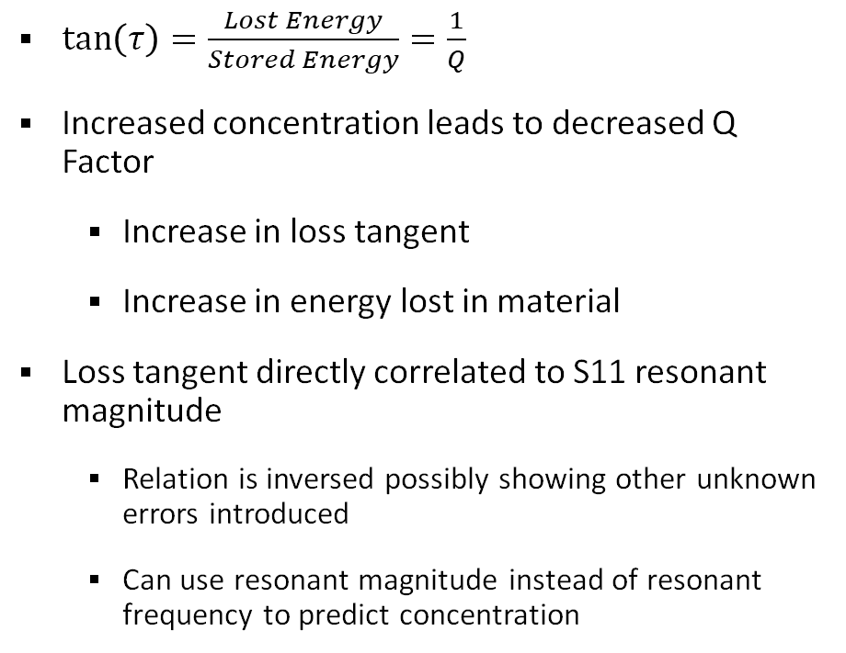
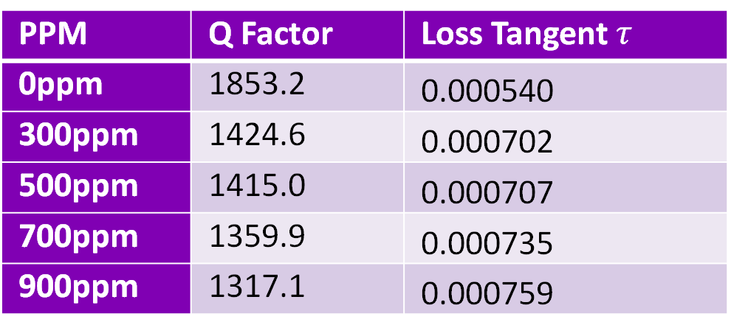
Test Results: Analysis
PPM | Q Factor | Loss Tangent $τ$
0ppm | 1853.2 | 0.000540
300ppm | 1424.6 | 0.000702
500ppm | 1415.0 | 0.000707
700ppm | 1359.9 | 0.000735
900ppm | 1317.1 | 0.000759
$\tan\left(τ\right)=\frac{Lost Energy}{Stored Energy}=\frac{1}{Q}$
Increased concentration leads to decreased Q Factor
Increase in loss tangent
Increase in energy lost in material
Loss tangent directly correlated to S11 resonant magnitude
Relation is inversed possibly showing other unknown errors introduced
Can use resonant magnitude instead of resonant frequency to predict concentration
Q Factor: describes how sharp of a peak the system's frequency response has
Notes:
Mackenzie
To understand this relationship, a relation to the Q factor and loss tangent must be made.
Recall that Q factor describes how sharp the peak of frequency response is and loss tangent measures energy lost in the material.
This means with an increase in loss tangent signifies an increase in energy lost in the material.
Since Q factor can be directly measured from testing, a loss tangent can be found for each concentration showing a consistent trend upwards with an increase in concentration shown in the table to the right.
Comparing 0ppm to 300ppm, there is a significant decrease in Q factor and an increase in loss tangent.
The loss tangent can then be correlated to the S11 resonant magnitude.
An increase in loss tangent means more energy is absorbed in the material so less energy is reflected to the VNA.
From the definition of S11, we know a decrease in reflected energy means a higher S11.
From the results, the opposite relationship was found contradicting the relationship that increased loss tangent should lead to lower S11.
There are many possible issues that could be causing this inversed relationship which I will talk about in the next section. Despite this, with the current results the resonant magnitude can still be used to predict the concentration.

Slide 29
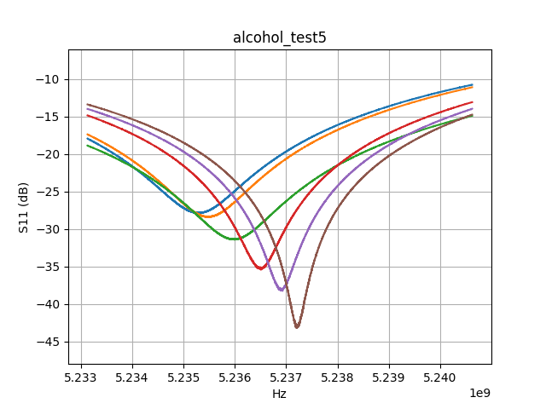
Errors and Limitations: Nonhomogeneous Fluids
Microplastics would clump in the system
Leads to non-homogenous samples
Simulations assumed homogenous
Prove this assumption using homogenous alcohol testing
Alcohol shows consistent frequency and magnitude shifting
Notes:
Mackenzie
Now I’ll go over the errors and limitations of the system.
Starting with the issue of non-homogeneous fluids in the resonator, it was observed that the plastics would tend to clump together.
If plastics were not uniformly distributed in the water, this would not change the dielectric constant in the same way as originally predicted and simulated.
To prove this prediction on the sample not being homogenous, a known homogenous sample of alcohol and water was used to test the resonator.
The same test as the microplastics was conducted but with increasing concentrations of alcohol instead. From the results, a very significant resonant frequency change of almost 30kHz for each step of concentration was observed.
This followed our prediction of the measured material increasing in frequency with an increase in concentration.
This showed that one of the issues with the original microplastic testing was the clumping causing non-homogenous samples.

Slide 30
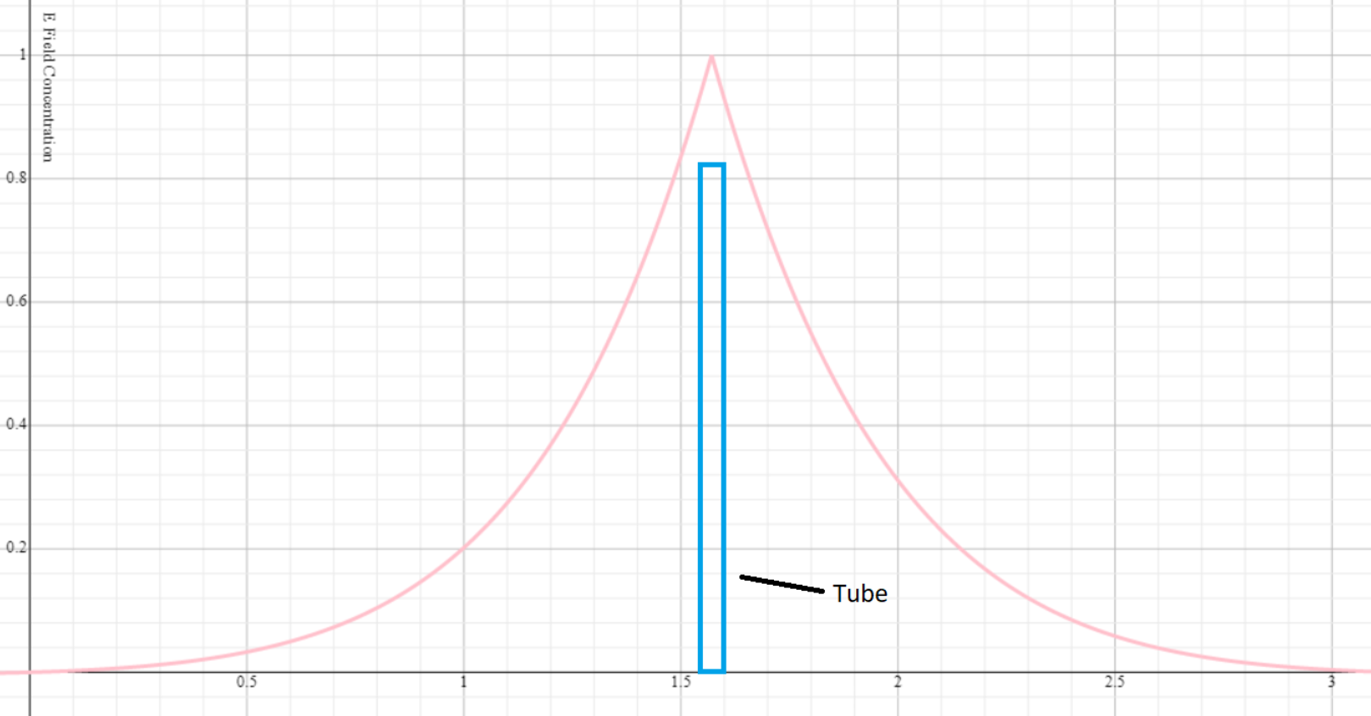
Errors and Limitations: Small Size of Fluid Tube
The size of the fluid column is too small
Promoted clogging of the system
Coupling factor to material too small
Larger tube
Higher coupling leading to more substantial frequency shift
Reduce clogging issues
Notes:
Mackenzie
The second issue with the cavity resonator was the fluid column going into the cavity resonator is not large enough to cause significant coupling between the incident wave and the material in the column.
This means that the incident wave did not significantly interact with the material causing the system to have very poor sensitivity to changes in frequency for a change in concentration.
To illustrate this point, the concentration of electric field is illustrated in the figure to the right with the electric field concentration on the vertical axis and the location within the cavity resonator on the horizontal.
Since the tube is so much smaller compared to the area of the E field concentration, there is not much area to allow coupling between the electric field and the material.
With a larger tube, more coupling would occur leading to a more substantial frequency shift with change in concentration.
The second issue that arises with a tube that is too small is the clumping microplastic can completely clog the fluidic system by getting stuck in the small diameter tube.
The only solution to a problem such as this is to increase the tube diameter.
Increasing the diameter of the tube would solve two problems by increasing the coupling factor and solving the clogging issue within the fluidic system.

Slide 31
Errors and Limitations: Characterizing Material
Relied on validity of previous research
Research paper found dielectric constant increased with concentration
Did not find this in testing
Characterize material before designing resonator
Difficult to know dielectric properties of materials
Understanding the material before designing sensor
Notes:
Mackenzie
Finally, the last error was the design of the resonator was based off of the characterization of the microplastics from a research paper.
It is not always known exactly how another researcher came to their exact results, and when we came to different results there is no way to know what the original error was.
Because of this, basing our design off research results was not the right approach and a better way is to first characterize the microplastics ourselves.
Once the material has been fully characterized including its dielectric constant, loss tangent and other properties the resonator can then be properly designed.
This would allow us to better correlate real-world results to our simulations.

Slide 32
Improvement For Future Revisions
Refine the Design through change of tubing and port location
Characterize the dielectric properties of the microplastic samples
Reach out to the research paper authors
Develop alternative designs
Iterate the design to tune the system to match with the simulation results
Notes:
Mackenzie
Based off of all of these observations, we can summarize all of them into improvements for future revisions into five points.
Read through points

Slide 33
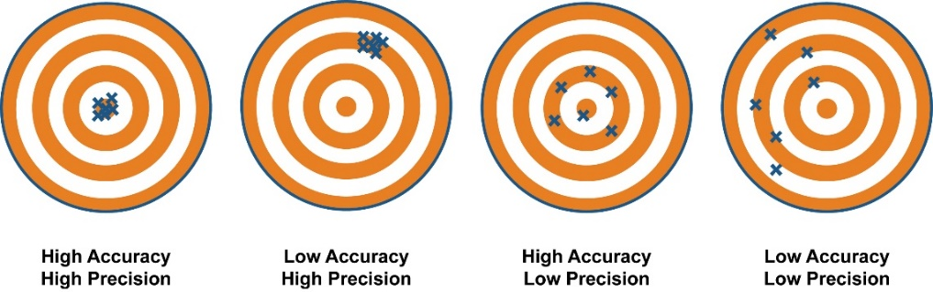
Primary Requirements Verification
The primary functional requirement of the system is that it shall measure the microplastic concentration of a sample within a specific precision and accuracy
Precision has been confirmed by repeated test results giving the same S11 response
Notes:
The primary functional requirement of the system is that it shall measure the microplastic concentration of a sample with a specific precision and accuracy. It is important to distinguish the difference between precision and accuracy.
Accuracy is the degree of closeness to a true value whereas precision is the ability to repeatedly produce the same results.
Precision has been confirmed by repeated test results giving the same S11 response.

Slide 34
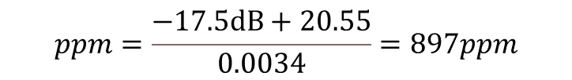
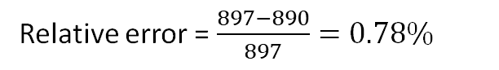
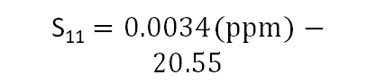
Primary Requirements Verification
S₁₁ $=0.0034(ppm)−20.55$
$$ppm=\frac{−17.5dB+20.55}{0.0034}=897ppm$$
Relative error = $\frac{897−890}{897}=0.78\%$
Notes:
Accuracy was confirmed by observing a consistent increase the magnitude of S11 vs microplastic concentration. An equation of the line can be found and used as a model to find the concentration of an unknown microplastic sample.
For example, to test the accuracy, a sample of 890ppm was prepared and measured using the system which gave a reading of -17.5dB. Using the model, a microplastic concentration of 897ppm can be calculated. This gives a relative error of 0.78% which is an acceptable error. As more test trials are performed and more data points are collected, the microplastic detection accuracy can be further improved.

Slide 35

design considerations review
Notes:
And that has wrapped up the analysis of our design. Now, in the following sections, we will review some of the design considerations made throughout the design.

Slide 36

Design For Safety, Regulatory, Sustainability
Safety
Regulatory
Sustainability
Project-related safety concerns were mitigated.
Product-related safety concerns are under evaluation.
Additional Safety Measures:
Use grounding wrist strap when working on PCB board to prevent buildup of static electricity on the body.
Wear gloves when testing with liquid to prevent conductive solutions from being in direct contact with body.
Carefully review the datasheets before purchase components to minimize toxic contents.
Use solder fan to dissipate toxic air when soldering with led on the PCB.
Regulatory aspects dependent on the application domain.
Reusable System Setup.
Proper Filtering prior to Sample Disposal.
Notes:
Let’s have a look at our design considerations for safety, regulatory and sustainability first. As we mentioned at the start of our presentation, our project is a technological demonstration, so most of the rules for product do not apply here. After careful evaluation and professional consultation, we can say that at the moment, the project-related safety concerns have been mitigated, and the product-related safety concerns are under evaluation. As for the regulatory aspects, they are dependent on the application domain.
But just to ensure absolute safety of the project, we have developed additional safety measures.
First, whenever we were working on the PCB, we were using the grounding wrist strap to prevent buildup of static electricity on the body and also prevent sensitive electronic components from being fried.
We also used gloves when dealing with sample solutions such that the liquid was never in direct contact with our body.
We have also minimized the presence of toxics through careful component selection and use of solder fan.
And to promote sustainability of the design, we’ve made the demonstration reusable and we properly filtered the sample solution before disposal.

Slide 37






Impact Of Design On Society And Environment
Impact to Society
Impact to Environment
Research Labs
Agriculture Industry
(Watering System)
Provides new analysis tool for different sectors
Provides powerful evidence of microplastics impact to raise awareness
Wastewater Facilities
Smart Home Sensing
Provides real-time data for microplastics in the environment
Accelerates the analysis for drinking water quality, pollution trends, and areas of imminent threat
Notes:
Looking back, we have also considered the impact of our design to the society and environment.
To the society, the demonstration provides a new direction for microplastic detection technology, which can be eventually used in research labs, wastewater facilities, the watering system of agriculture industry, and smart home sensing.
With the maturation of this technology, the ultimate design can provide a large number of data on microplastics. And this can act as powerful evidence of the microplastics impact to raise awareness of this issue.
And to the environment, the mature design can provide real-time data for microplastics in the environment, and many analysis can be accelerated such as the analysis of drinking water quality, pollution trend, and areas of imminent threat.

Slide 38
Project management
Notes:
As we’re getting close to the end of our presentation, we will review and reflect on the overall project management.

Slide 39




Project Management Strategy Overview
Clear division of work was defined and maintained throughout the course of the project
Project management tools such as were employed to track short and long-term goals and tasks
Tasks were completed according to earlier internal deadlines to account for any potential delays
Risk register and mitigation strategies were developed early in the project and continuously updated
Project Management
Notes:
I’ll first be discussing an overview of the project management strategies we employed throughout the duration of the project. From the start, we defined and maintained a clear division of work for the members to adhere to. Additionally, project management tools were employed. Specifically, Gantt charts were used to track short and long term goals, and Trello was used to track individual tasks. We also planned ahead of schedule by setting earlier internal deadlines to account for any potential delays. Finally, a risk register and relevant mitigation strategies were developed early in the project, and continuously updated throughout the year.

Slide 40
Budget vs. Expenditure
Items | Budget ($) | Actual Expenditure ($)
Electrical | 250 | 688.93
Mechanical | 80 | 109.26
Other | 310 | 48.32
Total | 640 | 848.19
Electrical budget was exceeded; major purchases include 3 cavity resonators, PCB fabrication, and 10 coax connectors
Mechanical estimate was very close to the actual spending; major purchases include the pump and tubing
Samples provided by the Guelph lab were free of charge which greatly reduced the miscellaneous expenses
Notes:
The MME and ECE departments provided us with a total of approximately $700 of funding. This table details our original estimated budget compared to our actual expenditure. As you can see, the actual expenses exceeded our budget, which was primarily due to unexpected material costs and introduction of new components such as the Arduino shield.

Slide 41
Lessons Learned
Notes:
Now, we finally move onto the lessons we’ve learned throughout the course of this project.

Slide 42
Lessons Learned
Employment of project management tools earlier and more consistently
More time and effort should have been allocated for research of potential other applications of this technology
Contingency plans should have been discussed more regularly and actively
Notes:
While we made a big effort to develop and implement a plan from the start of the project, no process is executed exactly as planned, and we have learned many lessons throughout this project.
Firstly, use of project management tools proved to be extremely effective when used, however resources such as Trello were employed only starting in January, and even afterwards there were periods where task allocation and tracking were performed more informally. For future projects in our careers, project management tasks should not only be implemented from the start of the project, but usage should be maintained throughout to ensure proper documentation and tracking of individual tasks.
Additionally, more time and effort should have been allocated to researching alternate applications of our project. Upon facing difficulty in achieving sample homogeneity, one of the options moving forward was to determine alternative applications for a design that employed homogeneous samples. Although some were found, earlier consideration of this risk and contingency plans would have been beneficial.
Similarly, contingency plans in general should have been more regularly and actively discussed during meetings so that when issues arose, there would already be a backup plan to employ.
Overall, things ran smoothly and we met our goals. Although there are imperfections, we are all very grateful of this whole learning experience! At the end of the day, all that matters is that each of us has taken something out of it to help us become better engineers in the future.

Slide 43
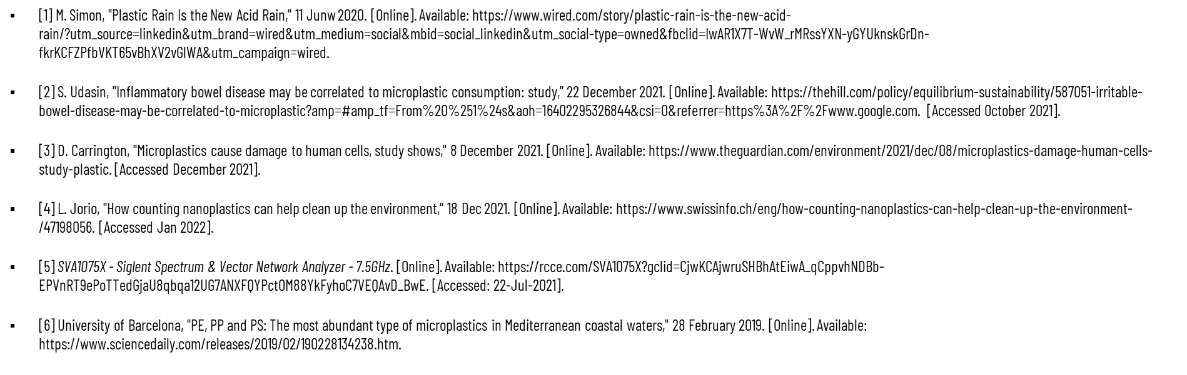
References
Notes:
This is the reference used if you are interested.

Slide 44
Thank you for listening! Questions?
Notes:
And that wraps up our presentation! Thank you for listening and we’re open to any question.

Slide 45
Backup slides
Notes:
And that wraps up our presentation! Thank you for listening and we’re open to any question.

Slide 46
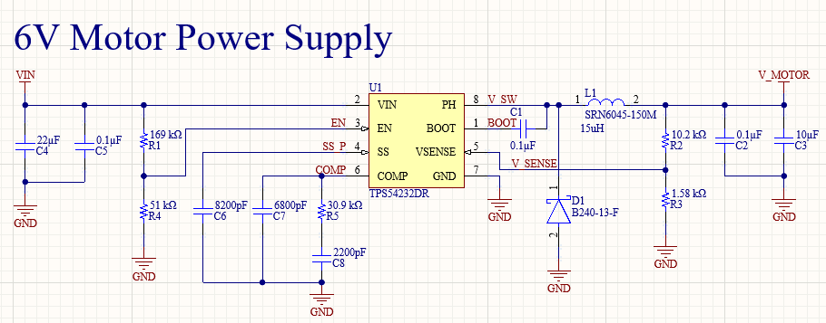
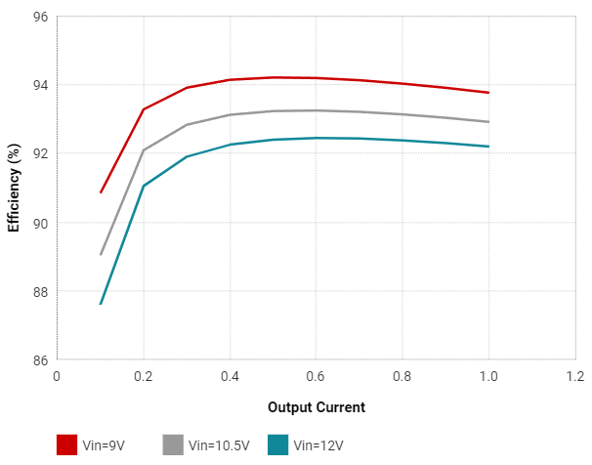
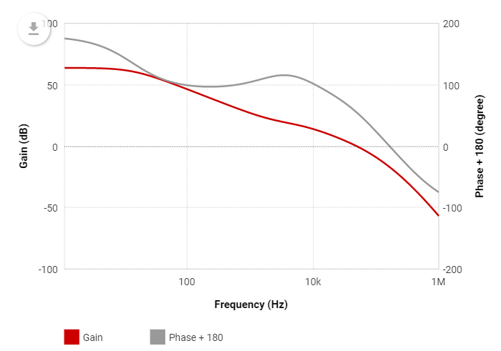
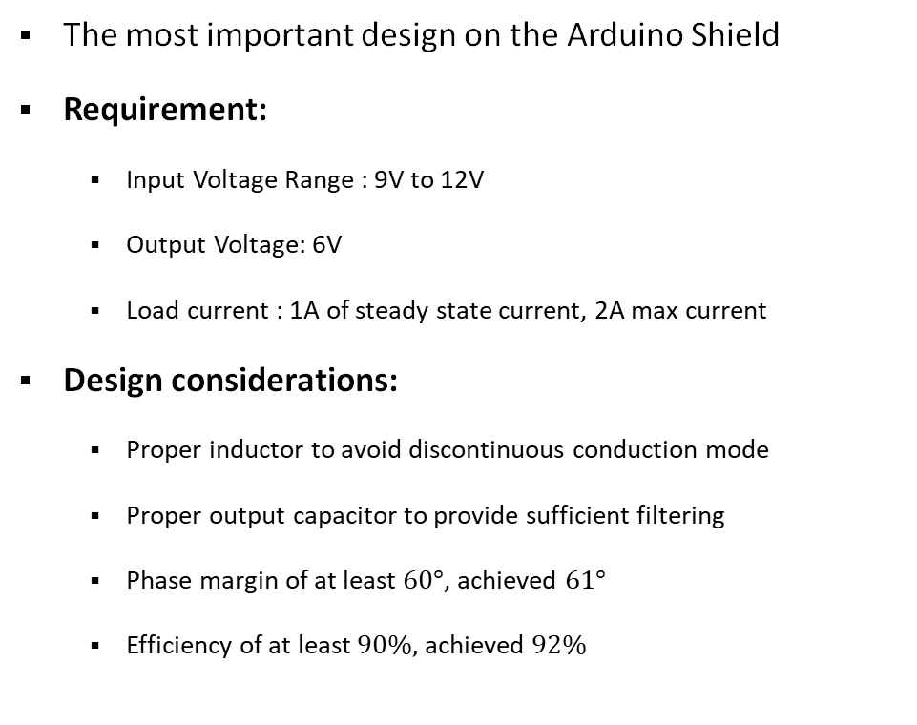
Pump System: Arduino Shield Power Supply Design
The most important design on the Arduino Shield
Requirement:
Input Voltage Range : 9V to 12V
Output Voltage: 6V
Load current : 1A of steady state current, 2A max current
Design considerations:
Proper inductor to avoid discontinuous conduction mode
Proper output capacitor to provide sufficient filtering
Phase margin of at least $60°$, achieved $61°$
Efficiency of at least $90\%,$ achieved $92\%$
Notes:
The most important design on the Arduino Shield is definitely the switching power supply. The requirement for the power supply is to step down the 12V input to a 6V output to power the motor. After testing the motor separately using a desktop power supply, we need 1A of steady state load current to ensure the motor can run properly throughout the entire operating range.
There are a few design considerations for the power supply. The inductor must be sufficiently large so the power supply does not enter discontinuous conduction mode. Discontinuous conduction mode occurs when the load current is very low, and the ripple current across the inductor hit zero. This will cause excess amount of ripple noise at the output which is undesirable. Although the motor has no requirement on the output ripple, the output ripple voltage still needs to be minimized so that if sensors are added, the analog readings on the sensors will not be disturbed by the power supply ripple noise. The output capacitor and inductor form a 2nd order LC filter, the output capacitor must be sufficiently sized so it will provide sufficient filtering and also handle large load transients. The phase margin is a very important metric in all analog electronic design. Generally speaking, a system with phase margin greater than 60 degrees is considered to be stable across all operating modes. With the equations provided in the power supply IC datasheet, the phase margin is designed to be 61 degrees, we can also increase the phase margin by changing the value of the compensation capacitors. Although the efficiency is not an important criteria for our system since it is plugged into the wall, but a well designed power supply should have efficiency of at least 90%, and we achieved 92%.

Slide 47

Impact of Design on Other Applications
Community Pharmacies and Hospitals
Problem:
no mean to verify the concentration of active particles in liquid drugs
Opportunity:
Fast verification tool before administering drugs to patients
Notes:
Now please allow me to digress for a brief moment.
As we mentioned earlier in our result analysis, our current system is still not ideal for microplastic detection because of the nonideal homogeneity of the sample solution. However, we have also seen from our alcohol test that when the solution is homogeneous, our system works perfectly well.
This means that the design can be used to detect concentration of a specific particle in a homogeneous solution.
After consulting with pharmacists and nurses, we have also discovered another interesting application of our design.
In fast paced environment such as the community pharmacies and hospitals, the pharmacists and nurses do not have a mean to verify the concentration of active particles claimed on the medicine, all they could do is to trust that the drug labels correct. Since our system can operate well for homogeneous solutions and it only takes a minute for each test, this design can serve as a drug verification tool for pharmacists and nurses before administering drugs to patients.

